Slide 1
Bias and the New York Times
By Ethan Moore and Mason Ogden

Slide 2
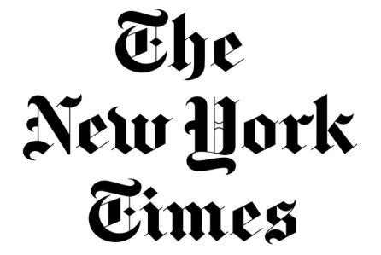
Background
The New York Times has been an essential American journalistic institution for more than a century, known for its objective reporting and ethical practices. However, recently that long-held credibility has been called into question by a large portion of the country, including none other than the President of the United States.

Slide 3
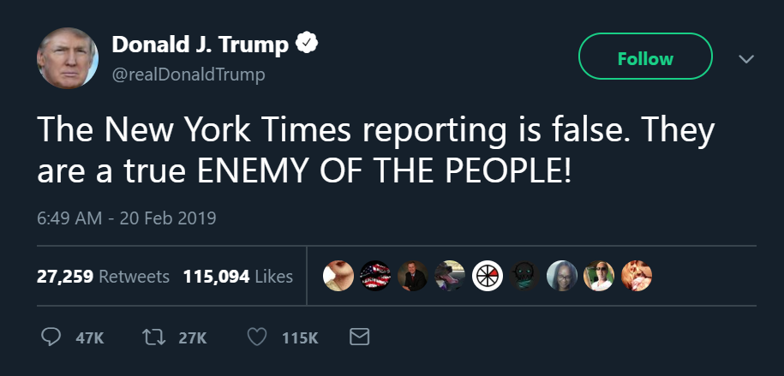

Slide 4
Background
Although a large part of this situation is purely political, it is interesting to think about the balance the New York Times is trying to maintain between objective reporting, informing the public, serving its local readership, and selling papers.

Slide 5
Research Question
We are interested in how the New York Times has represented various states in its articles recently and whether we can find any patterns that support or discredit the idea that NYT is representing certain geographic groups of people differently than others.

Slide 6

Getting the Data
We began to investigate this question by using the NYT API's "archive" endpoint to acquire a data frame of every piece of work published by NYT in January of 2019, the most recent data available.

Slide 7
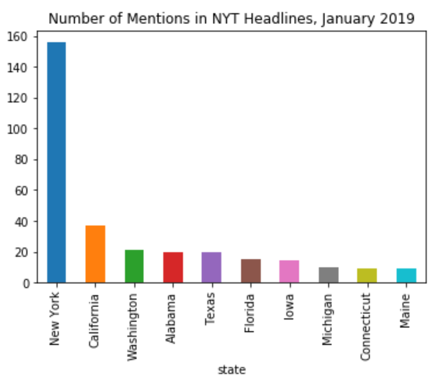
Exploring the Data
In our minds, the most obvious sign of bias would be total mentions
We investigated how many times each state appeared in January 2019 NYT headlines
Obviously, the most common state mentioned by far was New York.
Other than New York’s frequency, there’s no obvious pattern in frequencies.

Slide 8
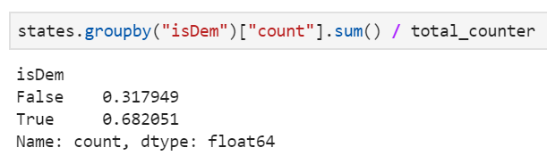
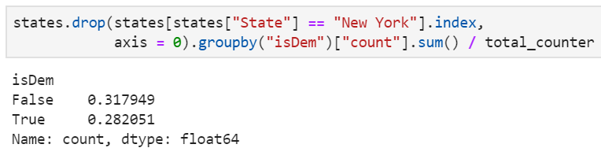
Trends
To answer our question, more than two-thirds of mentions of states in NYT headlines voted majority Democrat in the 2016 election. This seems like evidence of bias!
But keep in mind that 40% of state mentions in headlines over this time period were “New York”. When we filter those out, there does not appear to be a mention bias upon political lines

Slide 9
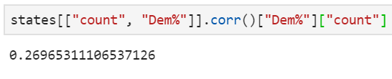
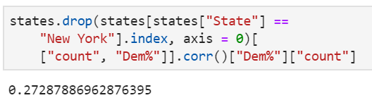
Trends (cont.)
Yet another way to evaluate the relationship between NYT mentions in January and political leaning in the last Presidential Election is to look at the correlation.
The simple correlation between appearing in a NYT headline and voting Democratic in the 2016 election is positive at about 0.27.
Interestingly, when we removed the outlier, New York, a liberal voting state, the correlation actually grew slightly more positive.
It is fair to say that there is a correlation between being a left-leaning state and being mentioned in NYT headlines during this time period.

Slide 10

Getting State Headlines
To get headlines that mentioned states specifically, we used the NYT API “article search” endpoint. We decided to analyze 100 headlines (the maximum allowed) for each of five different, and hopefully representative, states: New York, Colorado, Washington, Mississippi, and Texas.

Slide 11
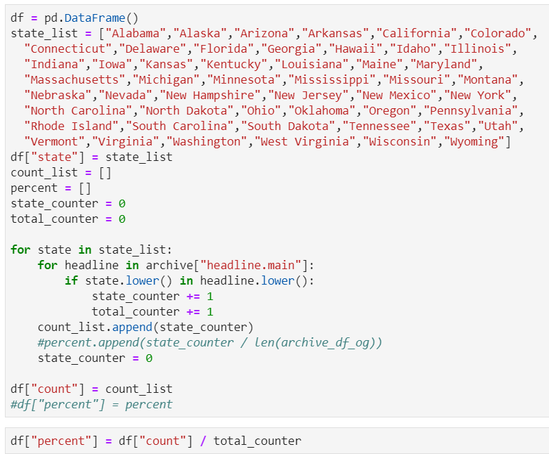
How Each State is Portrayed
We want to see how five states are portrayed in New York times headlines.
We found the most recent 100 headlines for New York, Colorado, Washington, Mississippi, and Texas
Extracted the fifteen most common words in each state’s headlines and plotted those frequencies.

Slide 12
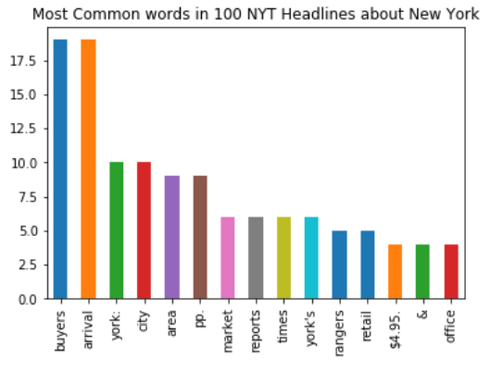
How New York is Portrayed
Lots of words related to commerce and expansion, such as:
Buyers
Arrival
Area
Market
Reports
Retail
Office
Overall, New York is portrayed by the NYT in a positive light, as a center of business and profit.

Slide 13
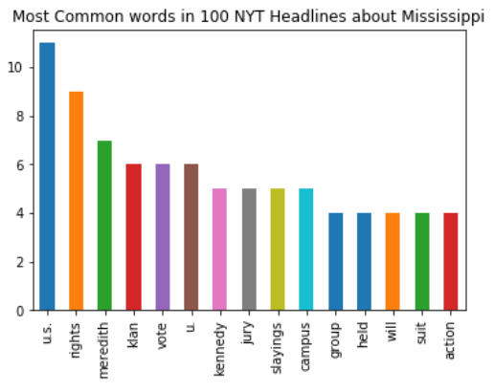
How Mississippi is Portrayed
Lots of words related to the justice system, such as:
Rights
Vote
Jury
Held
Will
Suit
Action
Also words related to civil rights issues and social justice:
Klan
Slayings
Campus
Group
Overall, NYT is portraying this conservative state in a negative light, though Mississippi is the worst in most state categories such as education, social justice, and poverty.

Slide 14
Using Markov Chains to Assess Sentiment
Knowing which words were used most commonly used in headlines about each state is informative, but may not pain the whole picture of how the states were portrayed in all of its headlines.
After training a Markov Chain on each set of 100 headlines, we generated many headlines. Here is a sample for each state.

Slide 15
Sample Headlines Generated by Our Markov Chain
New York:
Arrival of Buyers in New York
Colorado:
Flood Spreads in Colorado River Water
Washington:
Washington: The Bureaucratic Curtain
Mississippi:
Nightriders kill Mississippi Mob
Texas:
Commission Lifts Oil

Slide 16
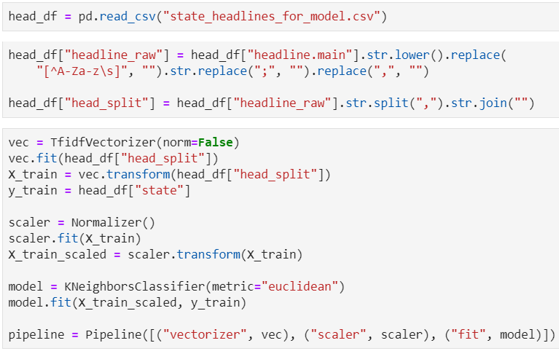
K-Nearest Neighbors Model
It was hard to tell whether the differences in headlines betweens states were significantly different, so we made a model to classify based on these differences.
The model used TF-IDF on the headlines and K-Nearest Neighbors Classifier to predict whether a headline came from New York, Colorado, Mississippi, Washington, or Texas.

Slide 17
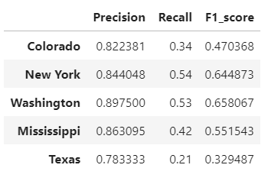
Evaluating the Model
The cross-validation accuracy of this model was 60%
Overall, our model had very good precision, with each state’s score being between 78% and 90%
However, recall scores were much lower and varied more, being between 21% and 54%
The F1 scores were somewhat adequate, being between 32% and 65%
Overall, the fact that if a headline is inputted into the model, we can predict what state it came from with 60% accuracy is pretty impressive.

Slide 18
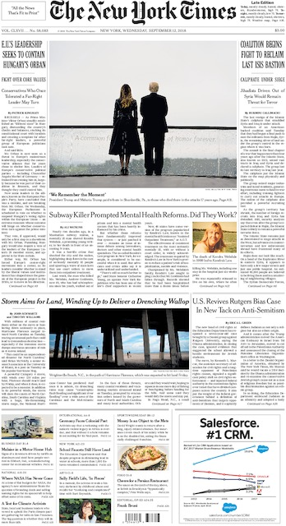
Conclusions
The sum of our analyses made one thing clear: New York Times headlines are consistently different in word choice for different states in different regions of the country. Although the tie to political bias may not be apparently strong based on our analyses, our takeaway from this project is that national headlines for different states are not always the same from state-to-state in word choice and therefore in sentiment.

